Slide 1
Usage of Abstract Classes, Interfaces, and Relatable
by
RAGE Uday Kiran

Slide 2
Extracting Hidden Patterns from Purchase Data
a, b, c, d, e, f, g, h
Assume a toy shop is selling the following items:
Customer-1 purchased the items a and b
TID | Items
1 | a, b

Slide 3
Extracting Hidden Patterns from Purchase Data
a, b, c, d, e, f, g, h
Assume a toy shop is selling the following items:
Customer-1 purchased the items a and b
Customer-2 purchased the items a, e and f
TID | Items
1 | a, b
2 | a, e, f

Slide 4
Extracting Hidden Patterns from Purchase Data
a, b, c, d, e, f, g, h
Assume a toy shop is selling the following items:
Customer-1 purchased the items a and b
Customer-2 purchased the items a, e and f
Customer-3 purchased the items c and d
TID | Items
1 | a, b
2 | a, e, f
3 | c,d

Slide 5
Extracting Hidden Patterns from Purchase Data
a, b, c, d, e, f, g, h
Assume a toy shop is selling the following items:
Customer-1 purchased the items a and b
Customer-2 purchased the items a, e and f
Customer-3 purchased the items c and d
TID | Items
1 | a, b
2 | a, e, f
3 | c, d
4 | a, b, h
5 | c, d
6 | a, c
7 | a, b
8 | e, f
9 | c, d, g
10 | a, b
TID | Items
11 | a, b
12 | a, c
13 | a, b
14 | b, e, f, g
15 | c, d
16 | a, b, d
17 | c, d
18 | a, c
19 | a, b, e
20 | c, d
.
.
.
Transactional database

Slide 6

Extracting Hidden Patterns from Purchase Data
TID | Items
1 | a, b
2 | a, e, f
3 | c, d
4 | a, b, h
5 | c, d
6 | a, c
7 | a, b
8 | e, f
9 | c, d, g
10 | a, b
TID | Items
11 | a, b
12 | a, c
13 | a, b
14 | b, e, f, g
15 | c, d
16 | a, b, d
17 | c, d
18 | a, c
19 | a, b, e
20 | c, d
Please help me in finding the useful information
Supermarket manager

Slide 7

Let us help the manager

Slide 8
TID | Items
1 | a, b
2 | a, e, f
3 | c, d
4 | a, b, h
5 | c, d
6 | a, c
7 | a, b
8 | e, f
9 | c, d, g
10 | a, b
TID | Items
11 | a, b
12 | a, c
13 | a, b
14 | b, e, f, g
15 | c, d
16 | a, b, d
17 | c, d
18 | a, c
19 | a, b, e
20 | c, d
What kind of patterns exist?

Slide 9

TID | Items
1 | a, b
2 | a, e, f
3 | c, d
4 | a, b, h
5 | c, d
6 | a, c
7 | a, b
8 | e, f
9 | c, d, g
10 | a, b
TID | Items
11 | a, b
12 | a, c
13 | a, b
14 | b, e, f, g
15 | c, d
16 | a, b, d
17 | c, d
18 | a, c
19 | a, b, e
20 | c, d
Idea
Let us mine frequent patterns

Slide 10
Model of Frequent Patterns
Toy shop
I ={i₁,i₂,…,i_{n}}, be a set of items
E.g., I={a, b, c, d, e, f, g, h}
TID | Items
1 | a, b
2 | a, e, f
3 | c, d
4 | a, b, h
5 | c, d
6 | a, c
7 | a, b
8 | e, f
9 | c, d, g
10 | a, b
TID | Items
11 | a, b
12 | a, c
13 | a, b
14 | b, e, f, g
15 | c, d
16 | a, b, d
17 | c, d
18 | a, c
19 | a, b, e
20 | c, d
Table 1: Transactional database

Slide 11
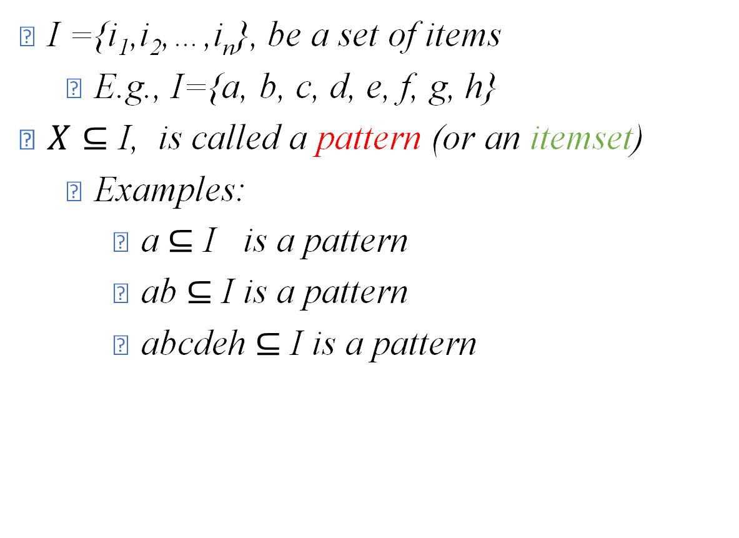
Model of Frequent Patterns
TID | Items
1 | a, b
2 | a, e, f
3 | c, d
4 | a, b, h
5 | c, d
6 | a, c
7 | a, b
8 | e, f
9 | c, d, g
10 | a, b
TID | Items
11 | a, b
12 | a, c
13 | a, b
14 | b, e, f, g
15 | c, d
16 | a, b, d
17 | c, d
18 | a, c
19 | a, b, e
20 | c, d
I ={i₁,i₂,…,i_{n}}, be a set of items
E.g., I={a, b, c, d, e, f, g, h}
$X⊆$ I, is called a pattern (or an itemset)
Examples:
a $⊆$ I is a pattern
ab $⊆$ I is a pattern
abcdeh $⊆$ I is a pattern
Table 1: Transactional database

Slide 12

Model of Frequent Patterns
TID | Items
1 | a, b
2 | a, e, f
3 | c, d
4 | a, b, h
5 | c, d
6 | a, c
7 | a, b
8 | e, f
9 | c, d, g
10 | a, b
TID | Items
11 | a, b
12 | a, c
13 | a, b
14 | b, e, f, g
15 | c, d
16 | a, b, d
17 | c, d
18 | a, c
19 | a, b, e
20 | c, d
I ={i₁,i₂,…,i_{n}}, be a set of items
E.g., I={a, b, c, d, e, f, g, h}
$X⊆$ I, is called a pattern (or an itemset)
E.g., ab $⊆$ I is a pattern
A transaction, t=(tid, X)
Table 1: Transactional database

Slide 13
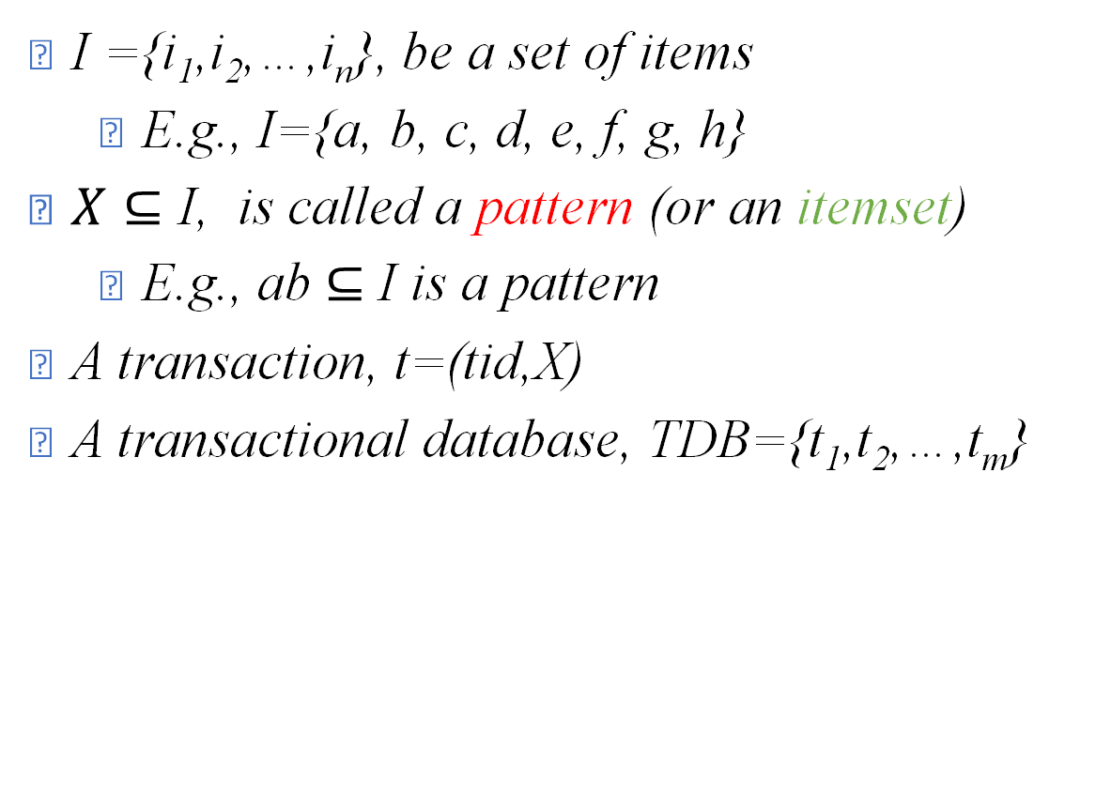
Model of Frequent Patterns
TID | Items
1 | a, b
2 | a, e, f
3 | c, d
4 | a, b, h
5 | c, d
6 | a, c
7 | a, b
8 | e, f
9 | c, d, g
10 | a, b
TID | Items
11 | a, b
12 | a, c
13 | a, b
14 | b, e, f, g
15 | c, d
16 | a, b, d
17 | c, d
18 | a, c
19 | a, b, e
20 | c, d
I ={i₁,i₂,…,i_{n}}, be a set of items
E.g., I={a, b, c, d, e, f, g, h}
$X⊆$ I, is called a pattern (or an itemset)
E.g., ab $⊆$ I is a pattern
A transaction, t=(tid,X)
A transactional database, TDB={t₁,t₂,…,t_{m}}
Table 1: Transactional database

Slide 14
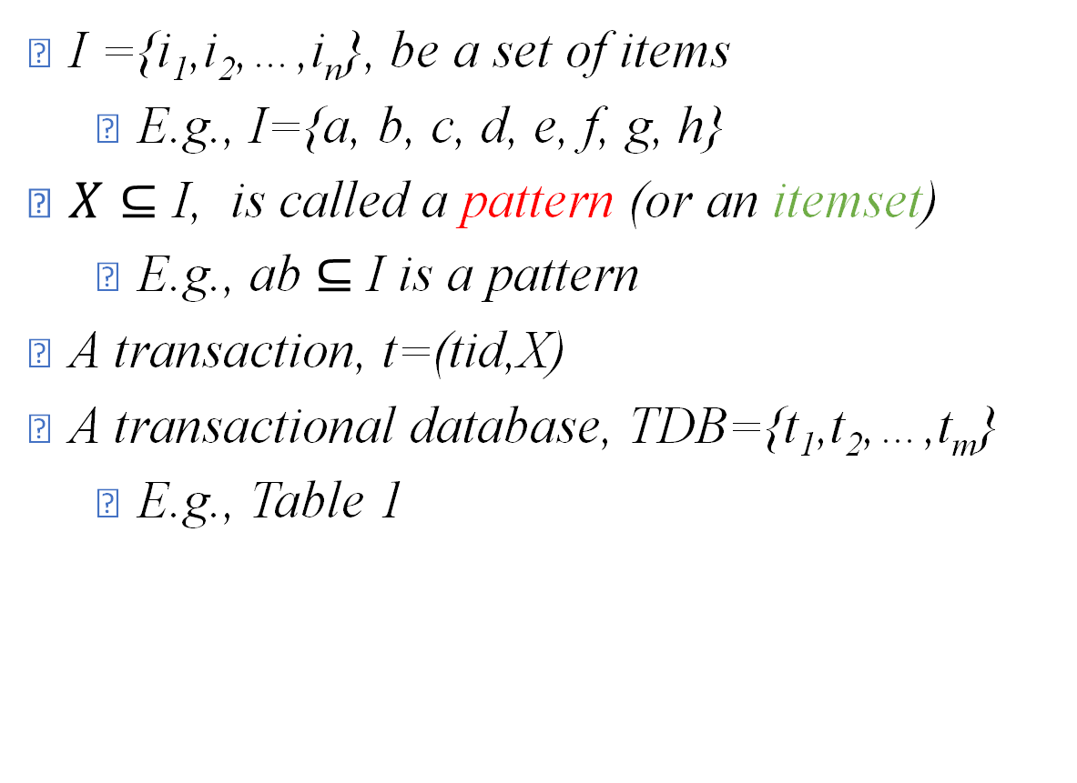
Model of Frequent Patterns
TID | Items
1 | a, b
2 | a, e, f
3 | c, d
4 | a, b, h
5 | c, d
6 | a, c
7 | a, b
8 | e, f
9 | c, d, g
10 | a, b
TID | Items
11 | a, b
12 | a, c
13 | a, b
14 | b, e, f, g
15 | c, d
16 | a, b, d
17 | c, d
18 | a, c
19 | a, b, e
20 | c, d
I ={i₁,i₂,…,i_{n}}, be a set of items
E.g., I={a, b, c, d, e, f, g, h}
$X⊆$ I, is called a pattern (or an itemset)
E.g., ab $⊆$ I is a pattern
A transaction, t=(tid,X)
A transactional database, TDB={t₁,t₂,…,t_{m}}
E.g., Table 1
Table 1: Transactional database

Slide 15
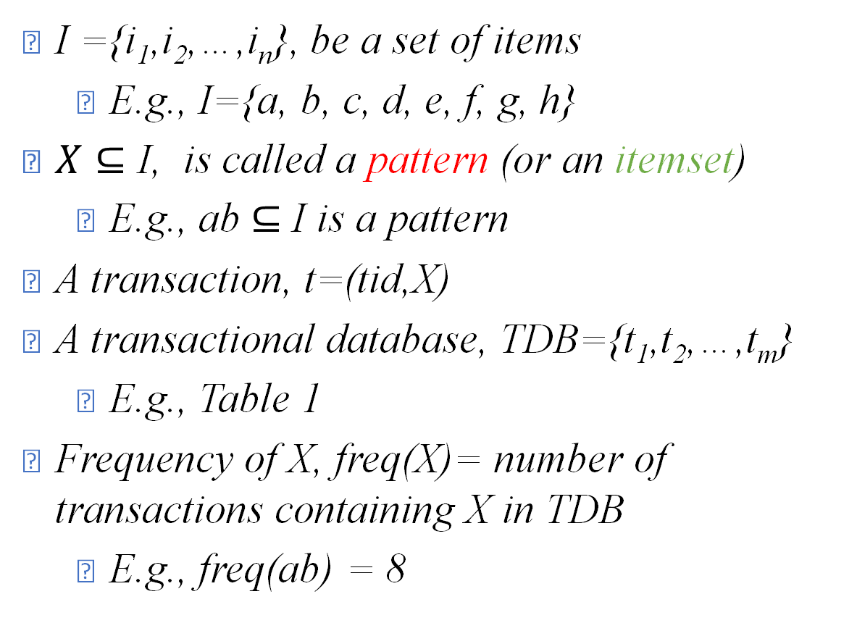
Model of Frequent Patterns
I ={i₁,i₂,…,i_{n}}, be a set of items
E.g., I={a, b, c, d, e, f, g, h}
$X⊆$ I, is called a pattern (or an itemset)
E.g., ab $⊆$ I is a pattern
A transaction, t=(tid,X)
A transactional database, TDB={t₁,t₂,…,t_{m}}
E.g., Table 1
Frequency of X, freq(X)= number of transactions containing X in TDB
E.g., freq(ab) = 8
TID | Items
1 | a, b
2 | a, e, f
3 | c, d
4 | a, b, h
5 | c, d
6 | a, c
7 | a, b
8 | e, f
9 | c, d, g
10 | a, b
TID | Items
11 | a, b
12 | a, c
13 | a, b
14 | b, e, f, g
15 | c, d
16 | a, b, d
17 | c, d
18 | a, c
19 | a, b, e
20 | c, d
Table 1: Transactional database

Slide 16
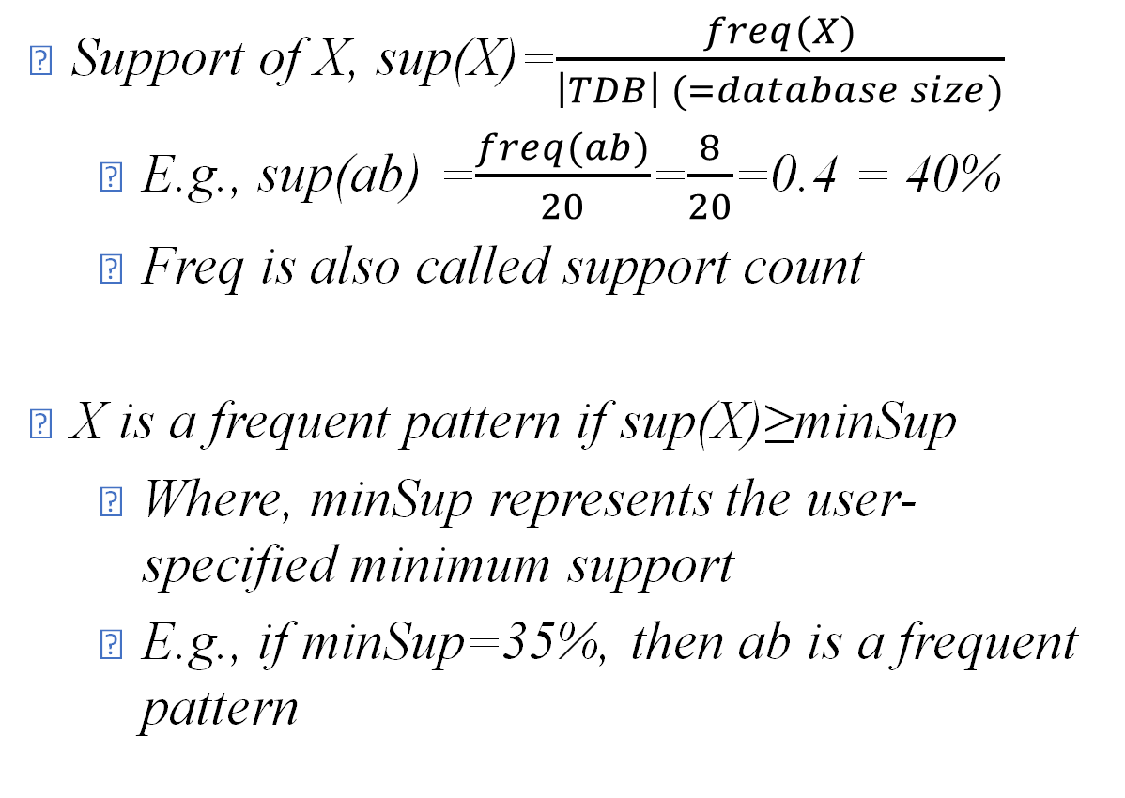
Model of Frequent Patterns
TID | Items
1 | a, b
2 | a, e, f
3 | c, d
4 | a, b, h
5 | c, d
6 | a, c
7 | a, b
8 | e, f
9 | c, d, g
10 | a, b
TID | Items
11 | a, b
12 | a, c
13 | a, b
14 | b, e, f, g
15 | c, d
16 | a, b, d
17 | c, d
18 | a, c
19 | a, b, e
20 | c, d
Support of X, sup(X)=$\frac{freq(X)}{\left|TDB\right| (=database size)}$
E.g., sup(ab) =$\frac{freq(ab)}{20}$=$\frac{8}{20}$=0.4 = 40%
Freq is also called support count
X is a frequent pattern if sup(X)≥minSup
Where, minSup represents the user-specified minimum support
E.g., if minSup=35%, then ab is a frequent pattern
Table 1: Transactional database

Slide 17
Your mathematical model is nice. Where is the algorithm?
Let us develop the algorithm
Supermarket manager

Slide 18
Apriori Algorithm
Let minsup count =3.
TID | Items
1 | a, b
2 | a, e, f
3 | c, d
4 | a, b, h
5 | c, d
6 | a, c
7 | a, b
8 | e, f
9 | c, d, g
10 | a, b
TID | Items
11 | a, b
12 | a, c
13 | a, b
14 | b, e, f, g
15 | c, d
16 | a, b, d
17 | c, d
18 | a, c
19 | a, b, e
20 | c, d
Table 1: Transactional database

Slide 19
Apriori Algorithm
Let minsup count =3.
Scan the database and find Candidate 1-patterns (C₁)
From C₁ find frequent 1-patterns( L₁)
TID | Items
1 | a, b
2 | a, e, f
3 | c, d
4 | a, b, h
5 | c, d
6 | a, c
7 | a, b
8 | e, f
9 | c, d, g
10 | a, b
TID | Items
11 | a, b
12 | a, c
13 | a, b
14 | b, e, f, g
15 | c, d
16 | a, b, d
17 | c, d
18 | a, c
19 | a, b, e
20 | c, d
C₁
Items | S
a | 12
b | 9
c | 9
d | 7
e | 4
f | 3
g | 2
h | 1
L₁
Items | S
a | 12
b | 9
c | 9
d | 7
e | 4
f | 3
minsup
Table 1: Transactional database
S = support count of the patterns.

Slide 20
Apriori Algorithm
Generate C₂ by joining L₁ with itself.
Scan the database and measure their support.
Find L₂ from C₂.
Repeat this process until no more L_{k} are found or C_{k} cannot be generated.
C₂
(=L₁ L₁)
C₂
L₂
Items | S
ab
ac
ad
ae
af
bc
bd
be
Items | S
bf
cd
ce
cf
de
df
ef
Items | S
ab | 8
ac | 3
ad | 1
ae | 2
af | 1
bc | 0
bd | 1
be | 2
Items | S
bf | 1
cd | 6
ce | 0
cf | 0
de | 0
df | 0
ef | 3
Items | S
ab | 8
cd | 6
ef | 3
No more C₃
minsup

Slide 21
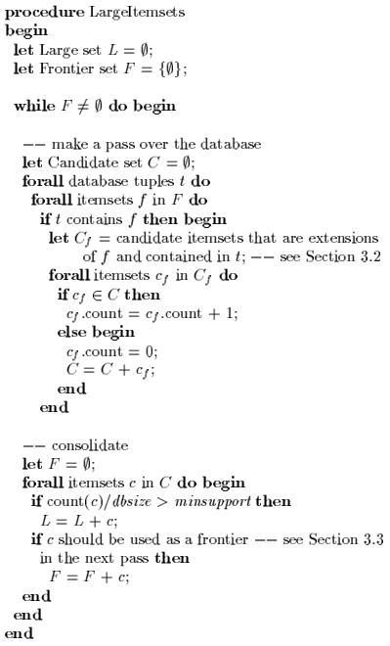
Pseudocode of Apriori algorithm
High-level coding of an algorithm

Slide 22
Apriori Algorithm Enhancements
TID | Items
1 | a, b
2 | a, e, f
3 | c, d
4 | a, b, h
5 | c, d
6 | a, c
7 | a, b
8 | e, f
9 | c, d, g
10 | a, b
TID | Items
11 | a, b
12 | a, c
13 | a, b
14 | b, e, f, g
15 | c, d
16 | a, b, d
17 | c, d
18 | a, c
19 | a, b, e
20 | c, d
Problem with basic Apriori: Too many database scans.
Apriori-TID
Apriori-BitString
Table 1: Transactional database

Slide 23
Writing software takes too much time
The algorithm is nice. Please provide the software with all three algorithms. I will pay you
Let me take the help of students
Supermarket manager

Slide 24

Sure professor
Students, please develop Apriori, Apriori-TID, Apriri-BitSet

Slide 25
Here are the codes of the algorithms
Oh My God!
There is no consistency between the codes
X
Apriori
Y
Apriori-TID
Z
Apriori-BitSet

Slide 26
Let me provide them with abstract class
Let us design the abstract class

Slide 27
Step 1: Preparing the class hierarchy
PAMI.frequentPattern.Algorithms (Apriori)
abstract class frequentPatterns{
}

Slide 28
Inputs
outputs
Step 2: Draw a blackbox with inputs and outputs
PAMI.frequentPattern.Algorithms (Apriori)
abstract class frequentPatterns{
}

Slide 29
database
minSup
Inputs
outputs
Step 3: Identify inputs
PAMI.frequentPattern.Algorithms (Apriori)
abstract class frequentPatterns{
}

Slide 30
database
minSup
frequent patterns
memory
runtime
Inputs
outputs
Step 4: Identify outputs
PAMI.frequentPattern.Algorithms (Apriori)
abstract class frequentPatterns{
}

Slide 31
database
minSup
frequent patterns
memory
runtime
mine()
getFPs()
getRuntime()
getMemory()
Inputs
outputs
Step 5: Identify the methods
PAMI.frequentPattern.Algorithms (Apriori)
abstract class frequentPatterns{
}

Slide 32
database
minSup
frequent patterns
memory
runtime
mine()
getFPs()
getRuntime()
getMemory()
Inputs
outputs
Step 6: Convert the blackbox into algorithm or code
PAMI.frequentPattern.Algorithms (Apriori)
abstract class frequentPatterns{
}
String database;
int minSup, memory, runtime;
List frequentPatterns;
abstract void mine();
abstract List getFPs();
abstract int getRuntime();
abstract int getMemory();

Slide 33
Sure professor
Students, use this abstract class for development
abstract class
frequentPatterns

Slide 34
Here are the codes of the algorithms
Thank you!
X₁
Apriori
extends FrequentPattern
X₂
Apriori-TID
extends FrequentPattern
X₃
Apriori-BitSet
extends FrequentPattern

Slide 35
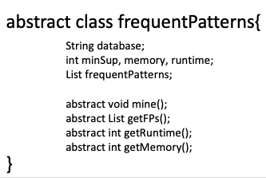
Let us work together
https://stackoverflow.com/questions/37916136/how-to-calculate-memory-usage-of-a-java-program
frequentPatterns.java
Apriori.java
AprioriTID.java
public class Apriori extends frequentPatterns{
}
public class AprioriTID extends frequentPatterns{
}
String database;
int minSup, memory, runtime;
List frequentPatterns;
… //your own variables
String database;
int minSup, memory, runtime;
List frequentPatterns;
… //your own variables
Apriori(String db, int minSup){
this.database=db;
this.minSup=minSup
}
public void mine(){
startTime = time()
//scan the database
endTime=time()
}
public List getFPS()
return frequentPatterns;
public int getRuntime()
return endTime-startTime;
public int getMemory()
return Runtime.getRuntime().totalMemory();
… //your own functions
Apriori(String db, int minSup){
this.database=db;
this.minSup=minSup
}
public void mine(){
startTime = time()
//scan the database
endTime=time()
}
public List getFPS()
return frequentPatterns;
public int getRuntime()
return endTime-startTime;
public int getMemory()
return Runtime.getRuntime().totalMemory();
… //your own functions

Slide 36
Question:Abstract vs. Non-Abstract Classes?
PAMI.frequentPattern.Algorithms (Apriori)
abstract class frequentPatterns{
}
PAMI.frequentPattern.Algorithms (Apriori)
class frequentPatterns{
}
String database;
int minSup, memory, runtime;
List frequentPatterns;
abstract void mine();
abstract List getFPs();
abstract int getRuntime();
abstract int getMemory();
String database;
int minSup, memory, runtime;
List frequentPatterns;
abstract void mine();
abstract List getFPs();
abstract int getRuntime();
abstract int getMemory();
What will happen here?
public class Apriori extends frequentPatterns{
}

Slide 37
Question:Abstract vs. Non-Abstract Classes?
PAMI.frequentPattern.Algorithms (Apriori)
abstract class frequentPatterns{
}
PAMI.frequentPattern.Algorithms (Apriori)
class frequentPatterns{
}
String database;
int minSup, memory, runtime;
List frequentPatterns;
abstract void mine();
abstract List getFPs();
abstract int getRuntime();
abstract int getMemory();
String database;
int minSup, memory, runtime;
List frequentPatterns;
abstract void mine();
abstract List getFPs();
abstract int getRuntime();
abstract int getMemory();
What will happen here?
What will happen here?
public class Apriori extends frequentPatterns{
}

Slide 38
Question:Abstract vs. Non-Abstract Classes?
PAMI.frequentPattern.Algorithms (Apriori)
abstract class frequentPatterns{
}
PAMI.frequentPattern.Algorithms (Apriori)
class frequentPatterns{
}
String database;
int minSup, memory, runtime;
List frequentPatterns;
abstract void mine();
abstract List getFPs();
abstract int getRuntime();
abstract int getMemory();
String database;
int minSup, memory, runtime;
List frequentPatterns;
void mine();
List getFPs();
int getRuntime();
int getMemory();
What will happen here?
What will happen here?
Nothing will be inherited from the superclass.
However, it ensures all variables and methos were implemented by the user at the subclass
variables and methods will be inherited depending on the modifier (public/protected, no-modifier)
Limitation: Code will be visible to others
public class Apriori extends frequentPatterns{
}

Slide 39
Thank you!
Please accept $1000
Here is the software!
Supermarket manager

Slide 40
After Few Months …

Slide 41


Limitation of Abstract Classes
Advertisement
Need best industrial developers for software development.
Professor, your software is very useful.
Sure! Let us go for news paper advertisement
Now, we want a professional version with industrial standards
We will develop
Supermarket manager

Slide 42
Limitation of Abstract Classes
We only need one developer
Let us choose the best one by competition

Slide 43

Limitation of Abstract Classes
Problem! I cannot share my abstract class with third party people
Then, how can we evaluate them?
Let them write their code from scratch.

Slide 44
Usage of Interfaces
public interface FrequentPattern {
void readFile(String fileName);
void startMining();
List getPatterns();
int totalPatterns();
}
We can provide interfaces
Interfaces do not contain code. They contain only:
Constants
Method names and
Nested types

Slide 45
public interface FrequentPattern {
void readFile(String fileName);
void startMining();
List getPatterns();
int totalPatterns();
}
Please use this interface to write your code
ok

Slide 46
Usage of Interfaces
public interface FrequentPattern {
void readFile(String fileName);
void startMining();
List getPatterns();
int totalPatterns();
}
public class Apriori implements FrequentPattern {
public void readFile(String fileName){
…
}
public void startMining(){
…
}
private List getPatterns(){}
public int totalPatterns(){}
}
A class that implements Interface must implement all methods of an interface.

Slide 47
Abstract Classes vs. Interfaces
Abstract Class | Interface
Fields can be non-static and non-final | All fields are static and final
Abstract classes are used only when there is a “is-a” type of relationship between the classes. | Interfaces can be implemented by classes that are not related to one another.
You cannot extend more than one abstract class. | You can implement more than one interface.
Abstract class can implement some methods also. | Interfaces can not implement methods.
With abstract classes, you are grabbing away each class’s individuality. | With Interfaces, you are merely extending each class’s functionality.

Slide 48
A Sample Interface, Relatable
Any class can implement Relatable if there is some way to compare the relative "size" of objects instantiated from the class.
For strings, it could be a number of characters;
For books, it could be a number of pages;
For students, it could be weight; and so forth;
For planar geometric objects, it could be area;
For three-dimensional geometric objects, it could be volume.
All such classes can implement the isLargerThan() method (see the RectanglePlus class that follows).

Slide 49
Implementing the Relatable Interface
public class RectanglePlus implements Relatable {
private int width = 0;
private int height = 0;
private Point origin;
public RectanglePlus() { // constructor
origin = new Point(0, 0);
}
public int getArea() {// a method for computing the area of the rectangle
return width * height;
}
public int isLargerThan(Relatable other) { // a method to implement Relatable
RectanglePlus otherRect = (RectanglePlus)other;
if (this.getArea() < otherRect.getArea()) return -1;
else if (this.getArea() > otherRect.getArea()) return 1;
else return 0;
}
}

Slide 50
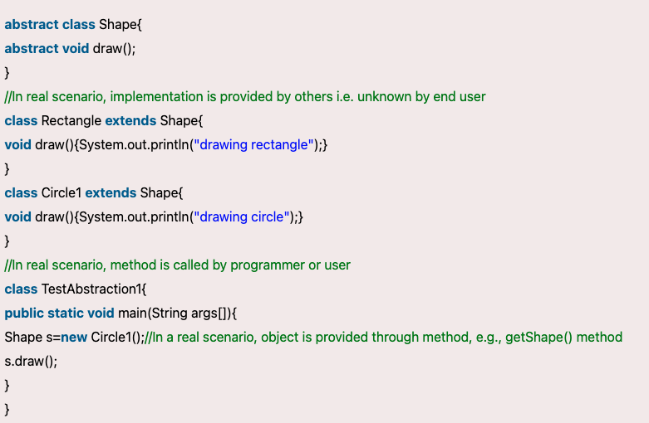
Understanding the Compiler Movement

Slide 51
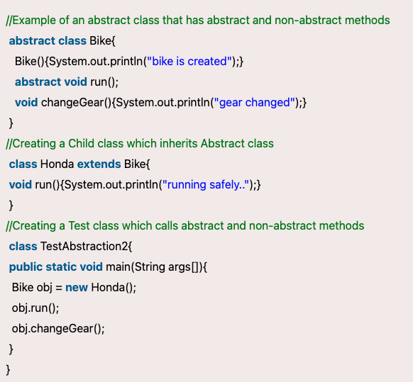
Understanding the Compiler Movement
Abstract class having constructor, data member and methods

Slide 52
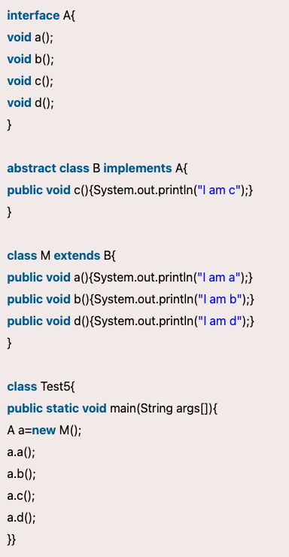
Understanding the Compiler Movement
Abstract class having constructor, data member and methods

Slide 53
public Object findLargest(Object object1, Object object2) {
Relatable obj1 = (Relatable)object1;
Relatable obj2 = (Relatable)object2;
// By casting object1 to a Relatable type, it can invoke the
// isLargerThan method
if ( (obj1).isLargerThan(obj2)) > 0)
return object1;
else
return object2;
}

